Slide 1



CPOL Antenna and DTMF Control Capstone Senior Design Project March 17th, 2015
Tim Bodkin
Kevin Helms
Chris Tatosian
Luis Ceja Quiroz

Slide 2
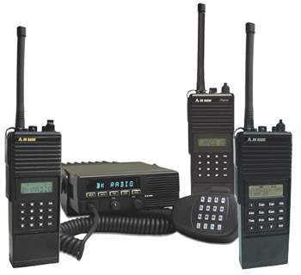
Problem Statement
Problem
Degraded signal integrity of the UCSC repeater due to local terrain
Solution
Improved reception by the addition of a circularly polarized antenna

Slide 3
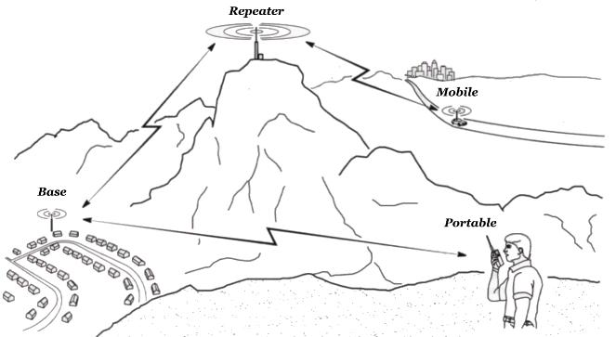
Problem Statement
Problem
Degraded signal integrity of the UCSC repeater due to local terrain
Solution
Improved reception by the addition of a circularly polarized antenna

Slide 4
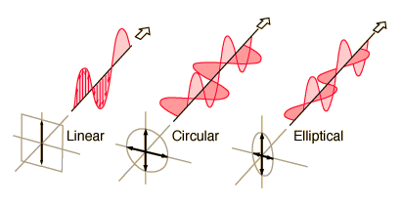
Problem Statement
Problem
Degraded signal integrity of the UCSC repeater due to local terrain
Solution
Improved reception by the addition of a circularly polarized antenna

Slide 5
Project Requirements
Circularly polarized antenna array
DTMF controller
Antenna switching circuit
RoIP nodes
Audio linking Interface
3

Slide 6
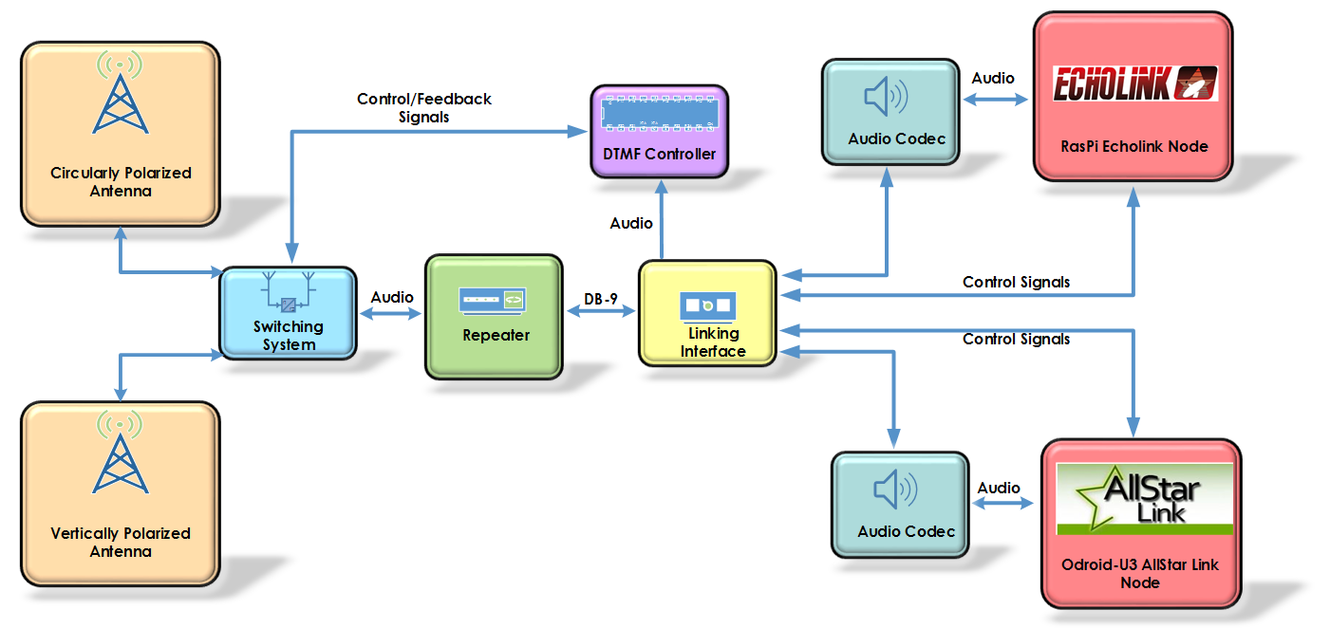


System Level Block Diagram

Slide 7
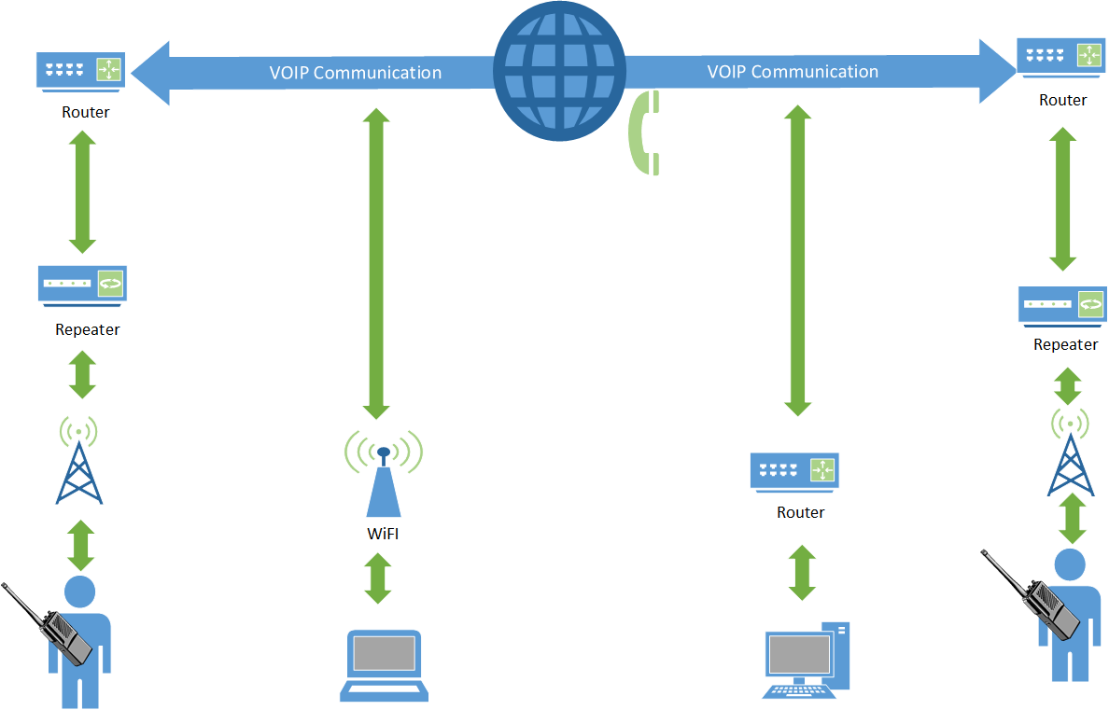
Radio over IP System Diagram

Slide 8
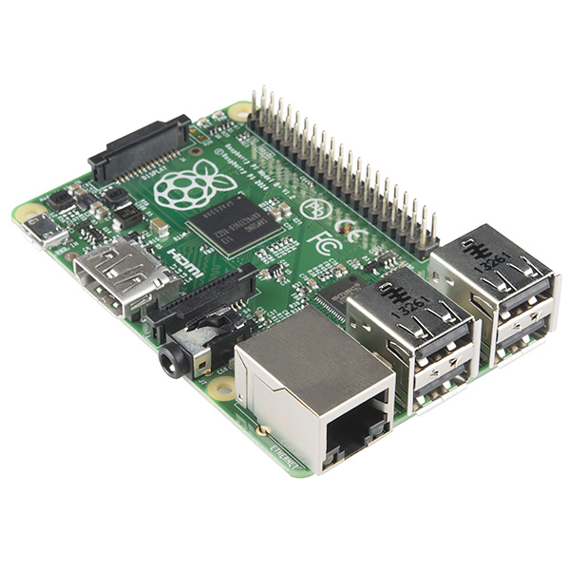
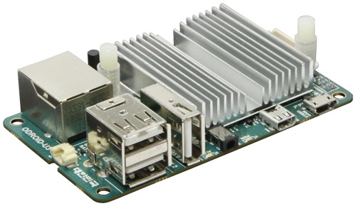
Implementation Details
Echolink Node
Raspberry Pi
CM-108 USB audio codec
Allstar Link Node
Odroid U3
CM-108 USB audio codec
Audio Linking Interface
Interface between RoIP systems, DTMF controller, and repeater
Audio mixing circuit
Audio distribution amplifier
Handles control logic between RoIP nodes
Raspberry Pi
Odroid U3

Slide 9
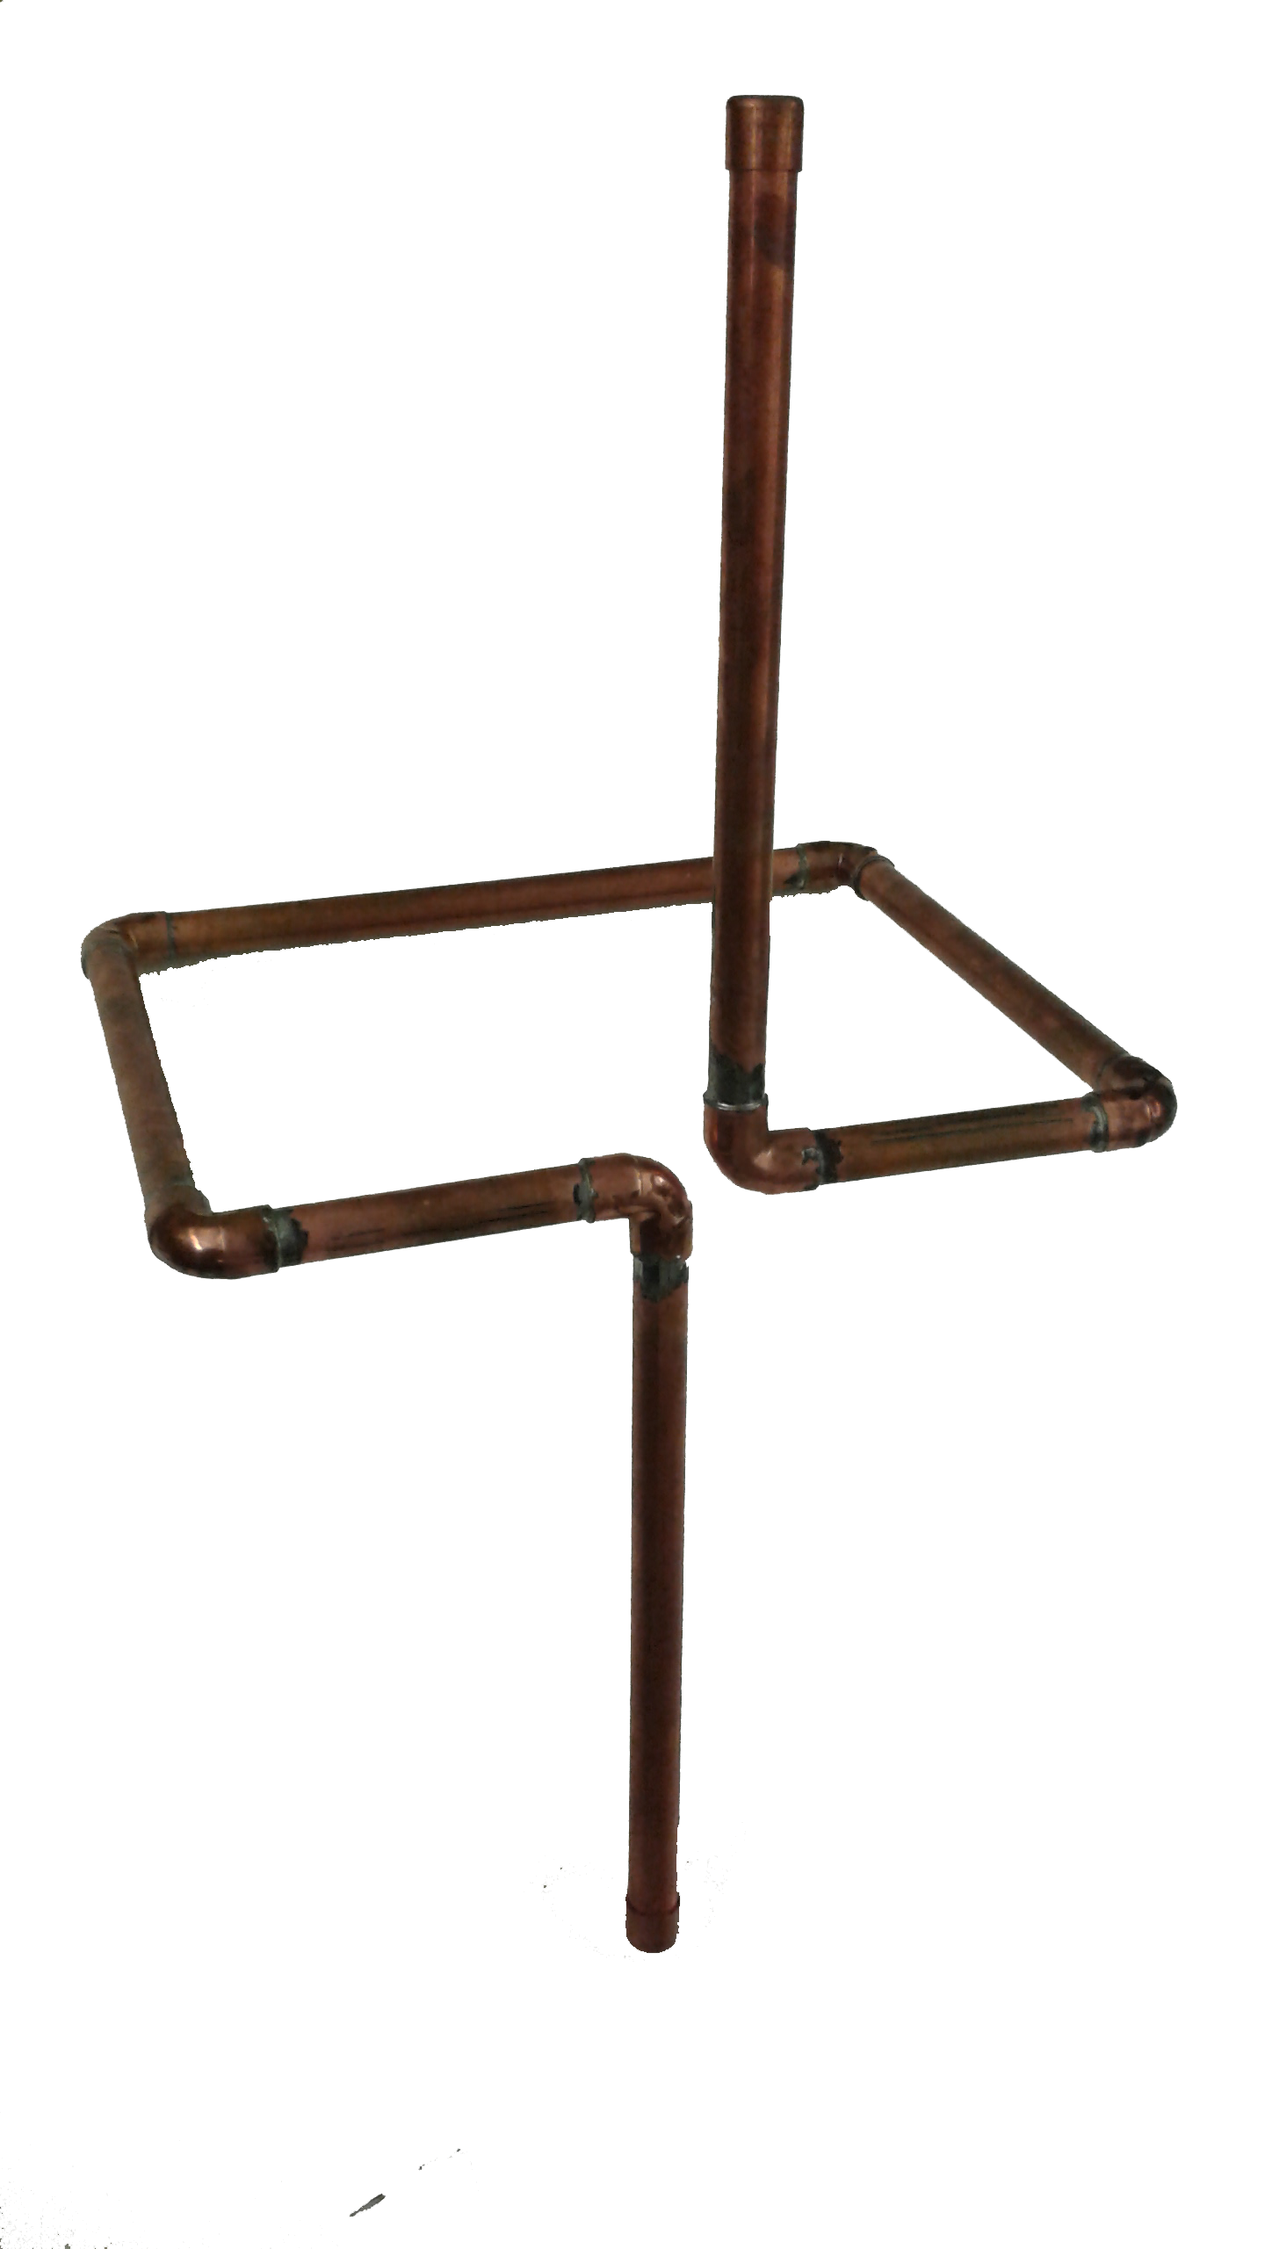
Implementation Details
Antenna
Copper tubing
Circular polarization
High gain
Balun
Impedance matching network
DTMF Controller/Switching Circuit
Wireless antenna selection via DTMF sequences
Switch between newly designed and existing antennas

Slide 10
Winter Quarter Results
Accomplishments:
Antenna prototype
Switching circuit prototype
Echolink node
DTMF Controller Design
Linking Interface Design
Spring quarter:
Finish prototyping
Test modules
Finalize designs
System integration

